Slide 1
Improving human recognition using image Classification

Slide 2
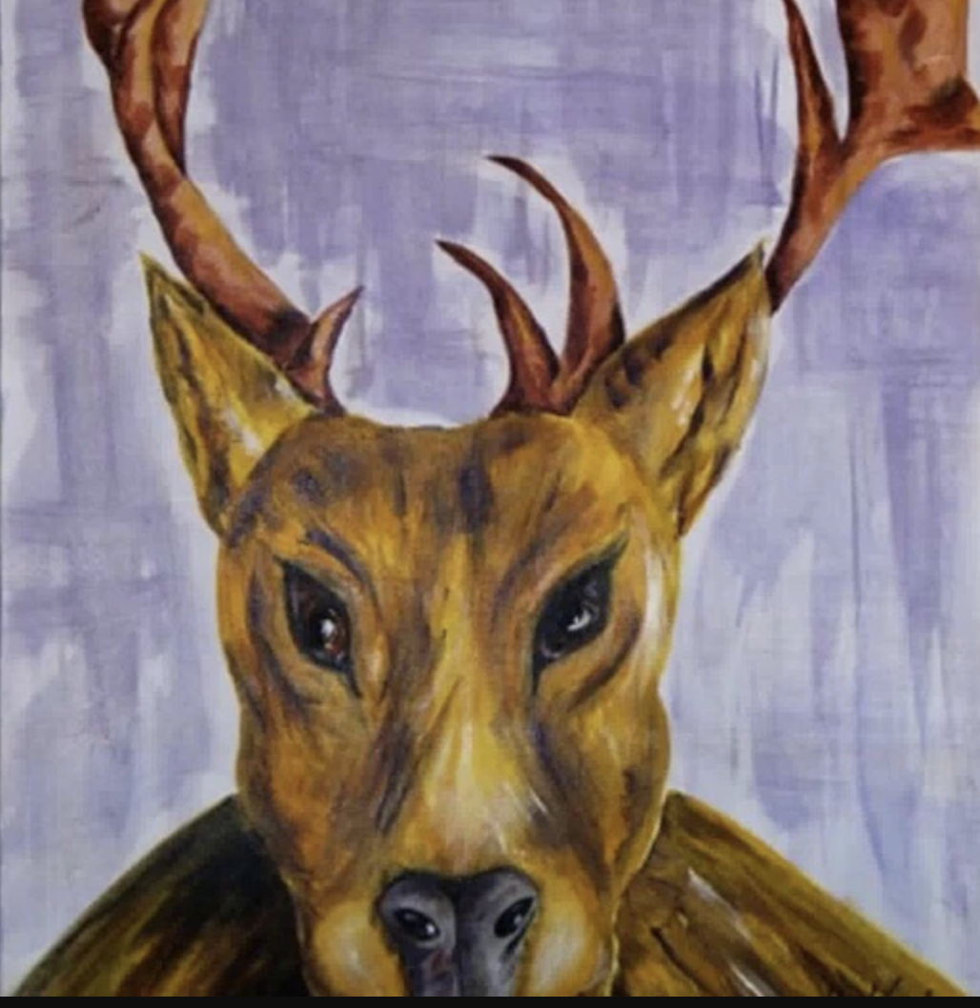
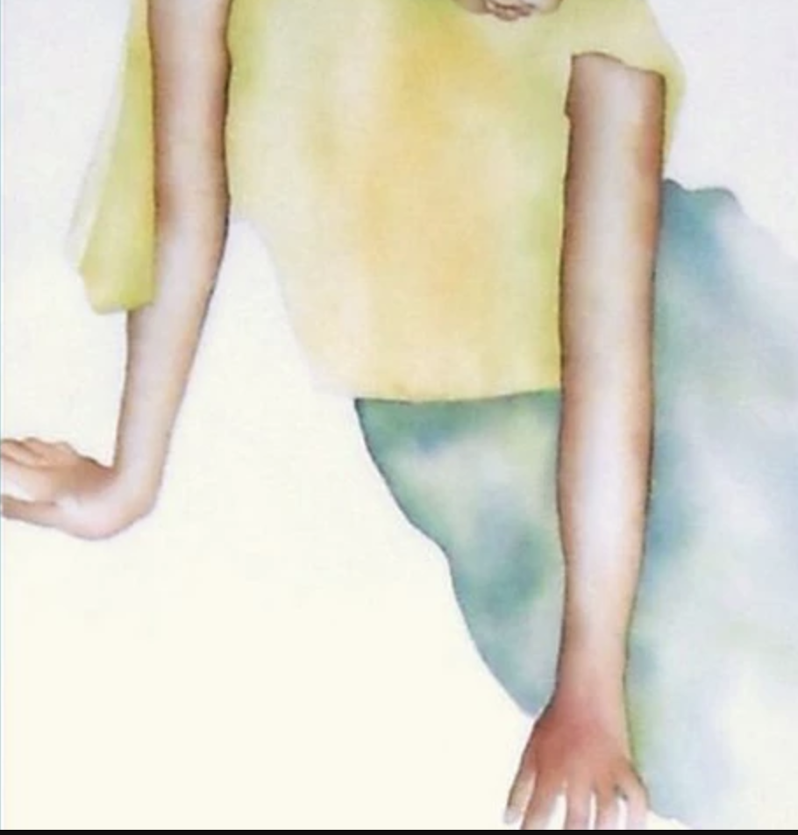
Include human? OR NOT?

Slide 3
Datasets
The images we collected:
Accessible Building Images: 54
nonhuman Images: 78
Split the dataset randomly, and the test_size = 0.2

Slide 4
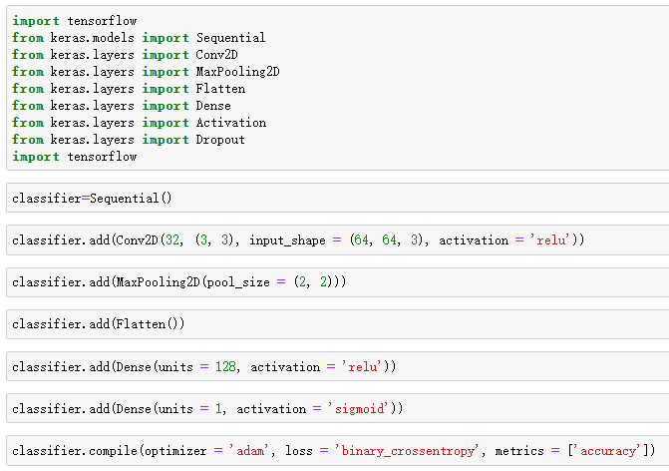
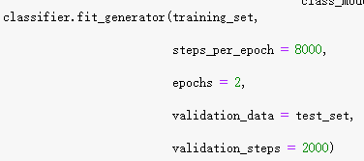
Code (V1.0)
Model:
Training:
Results:
Epochs=2:
Accuracy of training data: 98%
Accuracy of test data: 66%
Epochs=10:
Accuracy of training data: 99.67%
Accuracy of test data: 70.49%
Over Fitting!!

Slide 5
Image Data Augmentation In Keras
What is Data Augmentation?
It refers to increasing the amount of image data input using the following methods.
Rotation
Flip
Zoom
Shift
Scale
Contrast
Noise

Slide 6
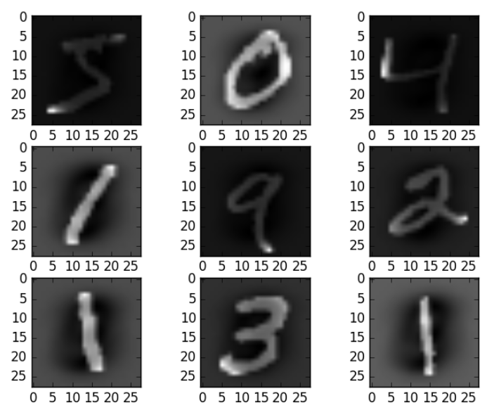
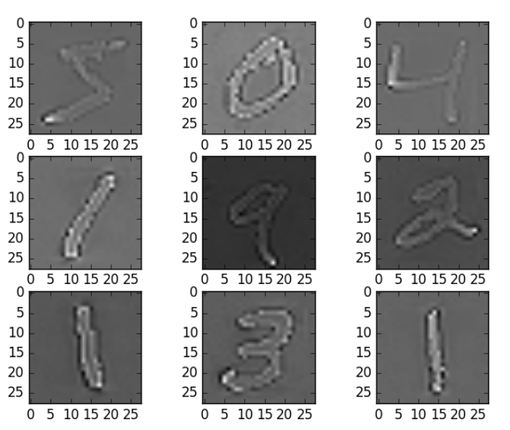
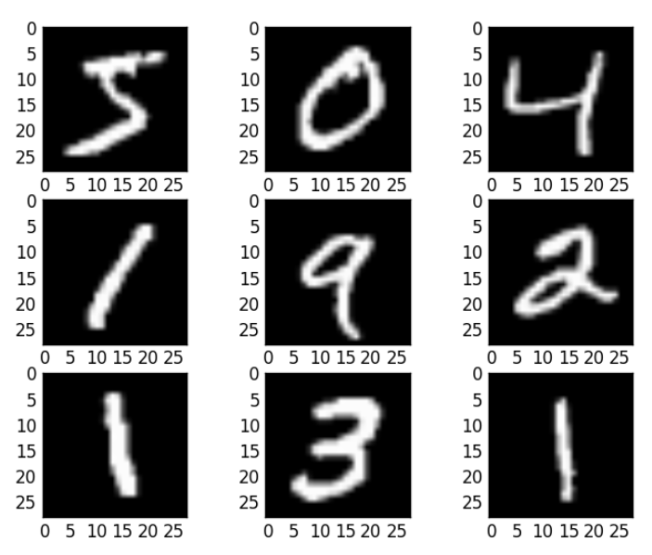
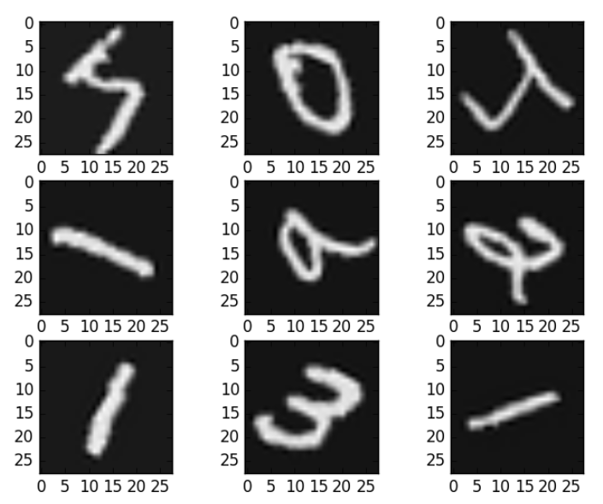
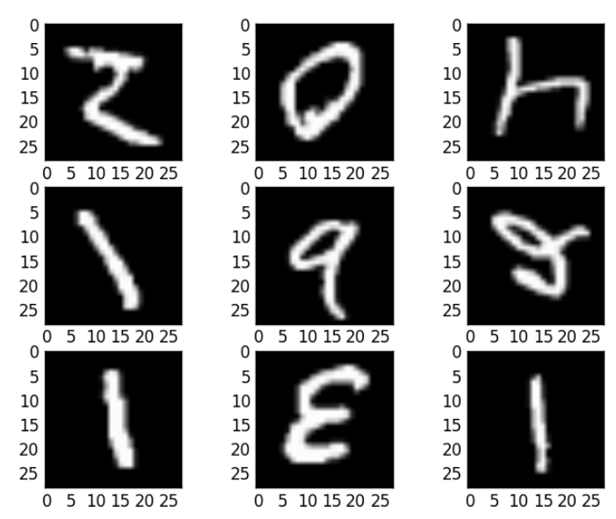
Image Data Augmentation In Keras
Feature Standardization
ZCA Whitening
Initial Datasets
Random Rotations
Random Flips

Slide 7
Image Data Augmentation In Keras
All of those images are saved as a part of the dataset
So that after we do the data augmentation, the number of our dataset of building accessibility model will be extended to almost 1000.
Also reduce the over fitting.

